Slide 1
Module 2 – looping statements

Slide 2
Types
For
While
Do while

Slide 3
1. for loop - Syntax
for (Initialization; Condition; Iteration)
{
Statements
}

Slide 4
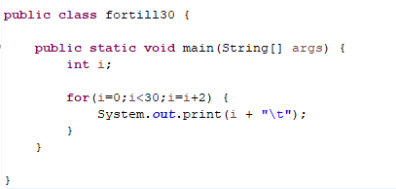
1. for loop - Example
Odd Numbers up to 30
1 3 5 7 9 11 13 15 17 19 21 23 25 27 29

Slide 5
TASK
Write a java program to print the multiplication table of a number using for loop.
Write a java program to print all the even numbers between 20 to 40.
Write a java program to find the average of N numbers using for loop.

Slide 6
while - Syntax
while (Condition)
{
Statements;
}

Slide 7
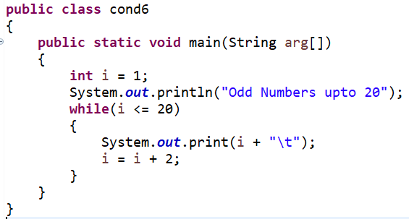
2. while - example
Odd Numbers upto 20
1 3 5 7 9 11 13 15 17 19

Slide 8
3. do-while - Syntax
do
{
Statements;
} while (Condition);

Slide 9
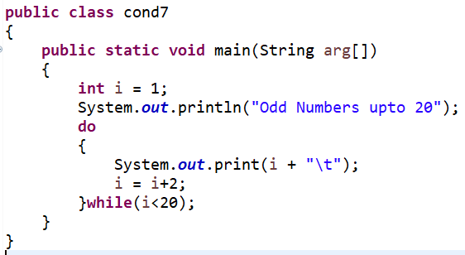
3. do-while - example
Odd Numbers upto 20
1 3 5 7 9 11 13 15 17 19

Slide 10
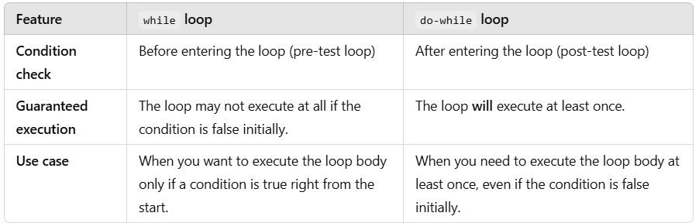

Slide 11
